Slide 1
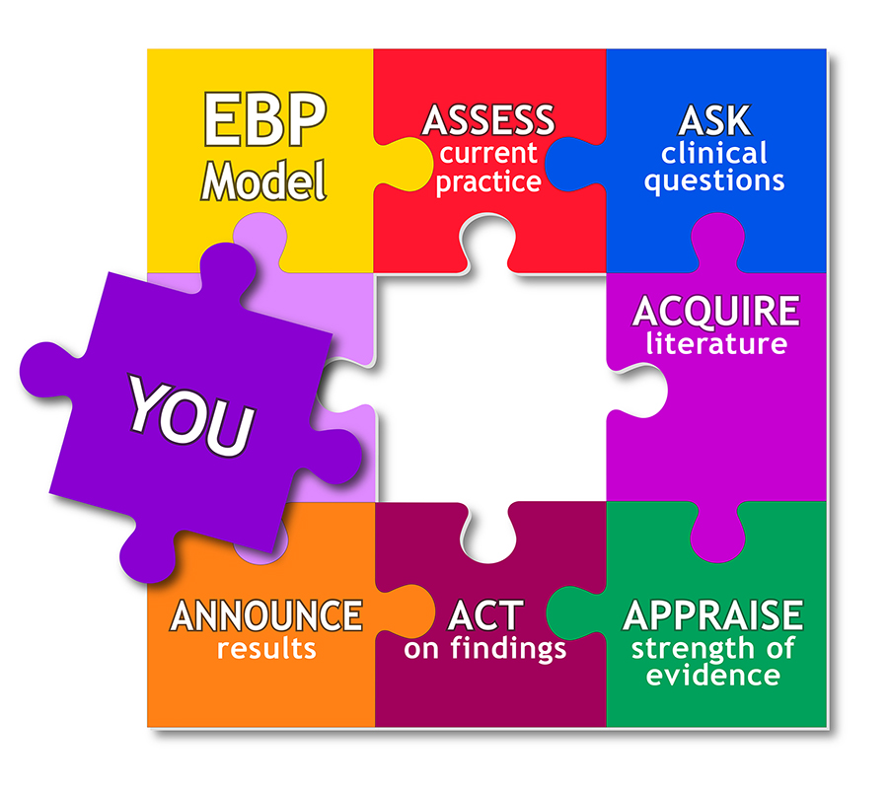
Evidence Based Approaches
Week 7-Slide
Evidence based Approaches

Slide 2

Aim;
Recognise the appropriateness of qualitative and quantitative research methodology application in research and evidence-based approaches.
Learning outcomes At the end of this lesson students will be able to ;
Explain qualitative and quantitative research methodology
Explore how qualitative and quantitative research methodology can lead to service improvement in evidence-based practice

Slide 3
EVIDENCE-BASED PRACTICE ensures that the best care is provided to patients and families, and the results include improved patient outcomes and satisfaction.
As nurses master evidence-based practice, they are faced with searching out the best evidence to support assessments and interventions, refine policies, and develop new practices.
Evidence-based practice (EBP) is the process of collecting, processing, and implementing research findings to improve clinical practice, the work environment, or patient outcomes.
... Utilizing the EBP approach to nursing practice helps us provide the highest quality and most cost-efficient patient care possible.
EVIDENCE-BASED PRACTICE

Slide 4
Evidence-based healthcare as a cyclical process.
Global healthcare needs, as identified by clinicians or patients/consumers, are addressed through the generation of research evidence that is effective, feasible, appropriate and meaningful to specific populations, cultures and settings.
This evidence is collected and the results are appraised, synthesized and transferred to service delivery settings and health professionals who utilize it and evaluate its impact on health outcomes, health systems and professional practice.
Therefore, in order to work in and use healthcare systems globally, one should consider evidence generation, different forms of evidence in a formal assessment called a systematic review (evidence synthesis),

Slide 5
Evidence-based healthcare as a cyclical process-c0nt.
dissemination of information in appropriate, relevant formats to inform health systems, health professionals and consumers (evidence transfer), and effective implementation of evidence and evaluation of its impact on healthcare practice (evidence utilization)
The best research evidence is usually found in clinically relevant research that has been conducted using sound methodology.

Slide 6
Aims of evidence based practice
To provide the high quality and most cost-efficient healthcare possible.
To advance quality of care provided by healthcare practitioners.
To increase satisfaction among patients.
To focus on healthcare practice away from habits and tradition to evidence and research.
It results in better patient outcomes.
It contributes to the science of healthcare practice.
It keeps practices current and relevant.
It increases confidence in decision-making.

Slide 7

Purposes and objectives
Evidence based practice seeks to replace practice as usual, with practice guided by rigorous outcome- oriented research, ideally randomized controlled trials.
It also seeks to make practice a less subjective enterprise, and to raise it to a higher level of accountability. It is associated with efforts to identify best practices in healthcare and other disciplines. (Baumann SL, 2010)

Slide 8
Features of EBP
Problem based and within the scope of the practitioners experience.
It brings together the best available evidence and current practice by combining research with knowledge and theory. So it narrows the research practice gap.
It facilitates application of research into practice by including both primary and secondary research findings.

Slide 9
Now…lets look at how qualitative and quantitative research methodology can lead to service improvement in evidence-based practice

Slide 10
LO 1 Activity
Individually, from the below video link:
Identify the difference between qualitative and quantitative research methodology
https://youtu.be/a-XtVF7Bofg
There are two approaches to collecting and analysing data: qualitative research and quantitative research.
This video will explain the differences between the two research methods, as well as the mixed-methods approach.
Intro - 0:00​
1. Main differences: 0:14​
2. When to use qualitative vs. quantitative research: 0:55​
3. Using two approaches to answer the same research question: 1:22​
4. Data collection methods: 2:50

Slide 11
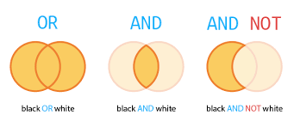

Slide 12
Activity
Individually, from the below video link:
Identify the difference between qualitative and quantitative research methodology
https://youtu.be/bCuwX35MHyE

Slide 13
Differences between Qualitative and Quantitative Research
QUALITATIVE | QUANTITATIVE
Methods include focus groups, unstructured or in-depth interviews, and reviews of documents for types of themes | Surveys, structured interviews, measurements & observations, and reviews of records or documents for numeric or quantifiable information
Primarily inductive process used to formulate theory or hypotheses | Primarily deductive process used to test pre-specified concepts, constructs, and hypotheses that make up a theory
More subjective: describes a problem or condition from the point of view of those experiencing it | More objective: provides observed effects (interpreted by researchers) of a program on a problem or condition
Text-based | Number-based
More in-depth information on a few cases | Less in-depth but more breadth of information across a large number of cases
Unstructured or semi-structured response options | Fixed response options, measurements, or observations
No statistical tests | Statistical tests are used for analysis
Less generalizable | More generalizable

Slide 14

Qualitative research
According to Denzin and Lincoln (2000), qualitative research is a distinct field of enquiry in its own right.
The literature indicates that qualitative research methodology refers to the ideas and principles that researchers use to base their procedures and strategies (methods)
Qualitative research presents its findings through participants’ words and stories, which are easily applied to nursing care practices.
Qualitative research can investigate practitioners' and patients' attitudes, beliefs, and preferences, and the whole question of how evidence is turned into practice.

Slide 15
Contribution of qualitative research to evidence-based practice?
Healthcare practitioners are attracted to qualitative research because its methods and findings often emulate the art of healthcare practice, where understanding the whole patient/ service users/residents and knowing patients individually matters.
Qualitative evidence provides richer, deeper and broader information based on a few individuals or case examples. This type of evidence is valuable for describing how and why.
The literature suggests that the contribution of qualitative research is growing and it is advancing healthcare knowledge, particularly in relation to certain aspects of that knowledge.
This implies it is important that healthcare practitioners in practice understand it and can judge its worth and relate it to their care of patients.

Slide 16
Quantitative and qualitative research methods generate valuable knowledge for our practice
Both quantitative and qualitative research methods generate valuable knowledge for our practice;
However, it is critical to identify which type of evidence provides the best answers for specific practice questions.
In quantitative approaches, data take the form of numbers, whereas in qualitative approaches, data usually take the form of text (ie, observation is transformed into text for the purpose of analysis). In qualitative approaches, reasoning is …

Slide 17
Contribution of qualitative research to evidence-based practice?
The patient brings to the encounter his or her own personal preferences and unique concerns, expectations, and values.
Health care that is evidence-based and conducted in a caring context leads to better clinical decisions and patient outcomes.
Gaining knowledge and skills in the EBP process provides nurses and other clinicians the tools needed to take ownership of their practices and transform health care.

Slide 18
Contribute of qualitative research to evidence-based practice?
Qualitative research, in particular, addresses research questions that are different from those considered by clinical epidemiology.
Qualitative research can investigate practitioners' and patients' attitudes, beliefs, and preferences, and the whole question of how evidence is turned into practice.
is a thoughtful integration of the best available evidence, coupled with clinical expertise. As such it enables health practitioners of all varieties to address healthcare questions with an evaluative and qualitative approach.

Slide 19
Contribute of qualitative research to evidence-based practice
It ensures a unique perspective and is often a relatively deep insight into human beings. It generates knowledge that is needed to care for patients as it is usually person centred, holistic, interactive and inductive.
It is based on ‘emic’ perspectives - views of people, their perceptions and meanings - and is useful for exploring knowledge questions related to feelings, behaviour, experiences and meanings.
Many experienced nurses have only relatively recently been introduced to qualitative approaches.
It is important to realise that knowledge created by quantitative research also has its place in enhancing patient care. For example, clinical trials provide the valuable data on oncology treatments and interventions.

Slide 20
Contribute of qualitative research to evidence-based practice- cont.
Qualitative methods can help bridge the gap between scientific evidence and clinical practice
Qualitative research findings provide rigorous accounts of treatment regimens in everyday contexts
This can help us understand the barriers to using evidence based medicine, and its limitations in informing decisions about treatment
Recognising the limits of evidence based medicine does not imply a rejection of research evidence but awareness that different research questions require different kinds of research

Slide 21
Contribute of qualitative research to evidence-based practice- cont.
In terms of practice knowledge created by qualitative research, it helps ensure patients are viewed as individual patients rather than medical conditions. In healthcare research this is an important perspective when trying to make effective policy and practice decisions (Bowling and Ebrahim, 2005)
They are useful methods that can perhaps look at issues in more depth from the patient perspective.
It advances nursing knowledge considerably and, importantly, it is valuable, as good qualitative research can be used to enhance patient care.
Conceptually and symbolically, qualitative findings are useful by increasing nurses' understanding of patients' experiences, thereby allowing for more tailored interventions in care, as well as the anticipation of problems that might be encountered by a particular patient in a particular context.

Slide 22

Contribute of qualitative research to evidence-based practice- cont.
A major contribution of qualitative research is that of generating hypotheses. When a qualitative study is being conducted, the findings often suggest hypotheses (recommendations) that can be tested in future research.
Practical example of contribution of qualitative research in EBA:
In a recent study on symptom management of chronic heart failure that included shortness of breath(14), employed a qualitative design to identify numerous self-care strategies used by patients (e.g., resting between physical activities).

Slide 23

Practical example of contribution of qualitative research in EBA:
Patients using resting between physical activities as a self-care strategy show greater decrease in the symptom of shortness of breath than patients who do not use this selfcare strategy.
With qualitative research, researchers learn about patient experiences through discussions and interviews. The point of qualitative research is to provide beneficial descriptions that allow insight into patient experiences.
"Hierarchies of research evidence traditionally categorize evidence from weakest to strongest, with an emphasis on support for the effectiveness of interventions.

Slide 24

Practical example of contribution of qualitative research in EBA:
Qualitative research in nursing mainly deals with the lived experiences of patients and nurses. In the field of chronic illness, qualitative research has brought to the open some of the processes chronically ill patients undergo and what it means living with chronic illness.
In addition, new insights were gained about the processes involved in receiving and in giving care.
Qualitative research about chronic illness provided nurses with understanding of the lived experience of patients. This understanding is essential for good nursing care.
However, qualitative research is not the only method and for some aspects of nursing not the adequate one. Qualitative and quantitative research are complementary.

Slide 25
What is quantitative research?
Quantitative:
Numerical or statistical information (data), which often comes from surveys, surveillance or from administration records. ... Quantitative evidence provides a good overall picture of a population or geographical region. It can also often be used to measure trends over time.
This type of evidence is valuable for describing who, what, where and when.
Quantitative research methods are frequently applied in health and social care research. They use objective measurements with statistical methods, mathematics, economic studies or computational modelling to enable a systematic, rigorous, empirical investigation.

Slide 26
Why is quantitative research important in healthcare?
The main strength of quantitative methods is in their usefulness in producing factual and reliable outcome data. After the effects of a given drug or treatment have been tested on a sample population, the statistic record of the observed outcomes will provide objective results generalizable to larger populations.
It provides healthcare practitionets with specific protocols to analyse current levels of efficiency, design new services or redesign existing services to enhance efficiency, and implement change efficiency

Slide 27
Examples of quantitative in healthcare
In health care, ground-breaking solutions often follow a new capacity for measurement and pattern finding.
For example, developing the ability to measure blood glucose levels led to better treatments of diabetes.
Florence Nightingale changed nursing forever with her careful measurements of hospital care outcomes.
Today, we’re in the midst of an even more significant change in the health care industry: Troves of data are mixing with technologies newly powerful enough to adequately analyze them.
As a result, the unprecedented pattern-finding power of quantitative analysis is remaking the health care industry.

Slide 28
Quantitative evidence:
Provides the empiric knowing necessary for practice, and qualitative evidence supports the personal and experiential knowing critical for practice
Quantitative research objectives can be to establish the incidence or prevalence of a health problem; the health personnel degree of adherence to a new intervention; or, the users' level of satisfaction with a service. Qualitative research aims at understanding what exists from social actors' perspectives.
In applied health research, descriptive studies can be used to examine trends and patterns in health and health care use that can help planning and monitoring, this refers to frequencies, averages and other statistical calculations.

Slide 29
Quantitative research
The statistical methods associated with quantitative research are well suited for figuring out ways to maximize dependent variables on the basis of independents, which translates into a capability for identifying and applying the interventions that can maximize the quality and quantity of life for a patient.
For many of these studies, it is necessary to use the tools of quantitative research, such as the evaluation of the quality of care, the satisfaction of services, health programs, among others.
This is the importance of knowing this area of research, complementing it with qualitative research and achieving mixed studies focused on caring for humans and their environment.

Slide 30
Quantitative research
Quantitative research is a process for gathering and statistically analyzing information that is measured by an instrument.
Empirical research is another name for this research method based on something that the researcher can measure precisely and accurately.
Quantitative analysis refers to the process of using complex mathematical or statistical modeling to make sense of data and potentially to predict behavior.
For example, you can measure the temperature or heart rate. When you gauge the effect of exercising on blood pressure, it is a research question that you can answer by conducting quantitative research because it is measurable. The unit of analysis is blood pressure measurements before beginning and after completing exercises.
There is much confusion between quantitative and qualitative research. Both methods are quite different as the basis of qualitative research is on something without precise measurement.

Slide 31
How does quantitative research contribute to evidence-based practice?
It provides scientific support for policies already in place. More evidence makes an existent policy more defensible.
It provides evidence opposing policies already in place. Evidence in opposition to policies may result in new policies.
The purpose of using quantitative research for nursing is that it uses an accurate approach for collecting and analyzing measurable data. It is number oriented and precise thus accuracy is high. It is also simpler to make conclusions because the numbers are clear.
The main strength of quantitative methods is in their usefulness in producing factual and reliable outcome data.
EXAMPLE:
After the effects of a given drug or treatment have been tested on a sample population, the statistic record of the observed outcomes will provide objective results generalizable to larger populations.

Slide 32
Benefits of Quantitative Research
It is precise- Quantitative research is a number based method. It provides very accurate results which are a crucial factor in medical field outcomes. It is also possible to generalize the results for an appropriate purpose.
Fast data collection- A major advantage of quantitative research is that it allows fast speed at which you can collect data. It is also simpler to analyze data faster than when you use other known- precise methods.
Generalization- You can use statistically valid random samples to generalize a survey to an entire population. The finding can be generalized even beyond the participant groups.
Anonymity- Quantitative research can be tailored to be anonymous. It is a helpful aspect when dealing with a sensitive issue for the patients.

Slide 33
Benefits of Quantitative Research
Complete and extensive picture- Quantitative evidence provides an excellent overalls picture for a geographical region or population. It is the type of evidence that describes who, what, when and where. Additionally, it helps to measure trends over time such as the frequency of measles outbreaks in a particular community.
For the success of quantitative research, it is necessary to narrow research studies to one problem you are surveying. They will produce more precise details with similarity to the situation at hand.
Reliable information from this type of research provides trustworthy statistics that create more confidence to make correct plans.

Slide 34
Quantitative measures used in healthcare sector
Most of the quantitative methods used by health services are based upon the ability of healthcare organisation and administration to count. For example, to determine service service efficiency, healthcare organisation count or account for their resources and services and for services.
Example are management actions designed to assess and improve the efficiency and effectiveness of a healthcare organisation always begin by counting what is currently being done.
Click on the link below for more examples of quantitative measures used in healthcare sector:
http://samples.jbpub.com/9780763758714/58714_ch01_lewis.pd

Slide 35
WRAP-UP
Question and Answer Session

Slide 36
https://www.ncbi.nlm.nih.gov/pmc/articles/PMC1112988/
Adapted from https://www.orau.gov/cdcynergy/soc2web/Content/phase05/phase05_step03_deeper_qualitative_and_quantitative.htm​
https://pubmed.ncbi.nlm.nih.gov/9370721/
https://www.nursingtimes.net/clinical-archive/public-health-clinical-archive/qualitative-research-and-its-role-in-nursing-knowledge-16-05-2006/
https://rds-nenc.nihr.ac.uk/how-we-can-help/quantitative-study-design/

Slide 37
The emic perspective is the insider's perspective, the perspective that comes from within the culture where the project is situated—for example, gender perspectives of women involved in a project in Afghanistan.
What is Emic perspective in qualitative research?
An emic perspective is the insider's view of reality. It is one of the principal concepts guiding qualitative research. An emic perspective is fundamental to understanding how people perceive the world around them. ... An individual's view of the world might not conform with “objective” reality.

